Slide 1
Machine Learning
Lecture 17a: Generative Bayes Classifiers
Dr. Beilun Wang
Southeast University
School of Computer Science
and Engineering

Slide 2


Roadmap

Slide 3
Course Content Plan
Regression (supervised)
Classification (supervised)
Unsupervised models
Learning theory
Y is a continuous
Y is a discrete
NO Y
About f()
Graphical models
About interactions among X1,… Xp
Reinforcement Learning
Learn program to Interact with its environment

Slide 4
Three major sections for classification
We can divide the large variety of classification approaches into roughly three major types
Discriminative
directly estimate a decision rule/boundary
e.g., support vector machine, decision tree, logistic regression,
e.g. neural networks (NN), deep NN
Generative:
build a generative statistical model
e.g., Bayesian networks, Naïve Bayes classifier
Instance based classifiers
Use observation directly (no models)
e.g. K nearest neighbors

Slide 5
Today: Generative Bayes Classifiers
Bayes Classifier (BC)
Generative Bayes Classifier
Naïve Bayes Classifier
Gaussian Bayes Classifiers
Gaussian distribution
Naïve Gaussian BC
Not-naïve Gaussian BC LDA, QDA

Slide 6
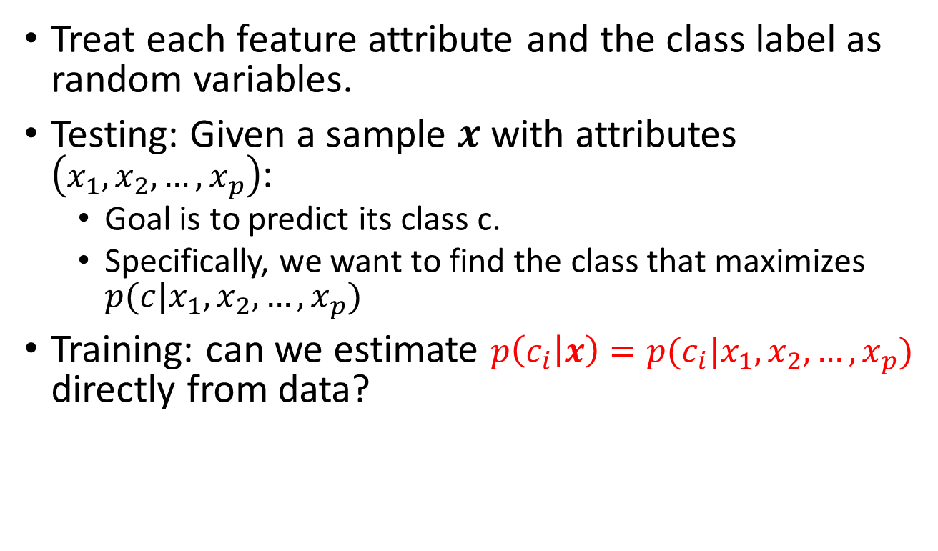
Review: Bayes classifiers (BC)
Treat each feature attribute and the class label as random variables.
Testing: Given a sample $x$ with attributes $\left(x_{1},x_{2},…,x_{p}\right)$:
Goal is to predict its class c.
Specifically, we want to find the class that maximizes $p(c|x_{1},x_{2},…,x_{p})$
Training: can we estimate $p\left(c_{i} | x\right)=p(c_{i}|x_{1},x_{2},…,x_{p})$ directly from data?
$$C_{MAP}={argmax}_{c_{i}∈C}p(c_{i}|x_{1},x_{2},…,x_{p})$$
MAP Rule

Slide 7
Review: Two kinds of Bayes classifiers via MAP classification rule
Establishing a probabilistic model for classification
Discriminative
Generative

Slide 8
Review: Discriminative BC
argmax P(c | X), C = {c₁ ,⋅⋅⋅,c_{L} }
c∈C
P(c₁ |x) P(c₂ |x) P(c_{L} |x)
• • •
Discriminative Probabilistic Classifier
• • •
x₁ x₂ x_{p}
x = (x₁ , x₂ ,⋅⋅⋅, x_{p} )

Slide 9
Review: Generative BC
P(X |C ) ,
C = c₁ ,⋅⋅⋅,c_{L} , X = (X₁ ,⋅⋅⋅, X_{p} )
P(x|c₁ )
P(x|c₂ )
P(x|c_{L} )
Generative Probabilistic Model for Class 1
Generative Probabilistic Model for Class 2
Generative Probabilistic Model for Class L
• • •
• • •
x_{p}
• • •
x_{p}
• • •
x_{p}
x₁ x₂
x₁ x₂
x₁ x₂
x = (x₁, x₂,⋅⋅⋅, x_{p} )

Slide 10
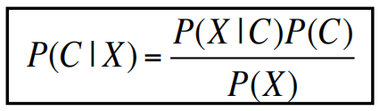
Review: Bayes Rule for Generative BC
Prior
P(C₁|x), P(C₂|x), …, P(C_{L}|x)
P(C₁), P(C₂), …, P(C_{L})
_{P(C |X) =} P(X |C_{i} )P(C_{i} )
i
P(X)

Slide 11
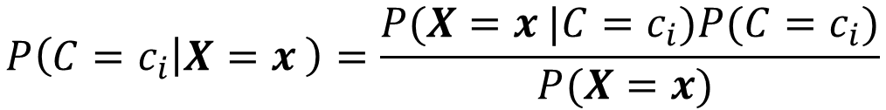


Summary of Generative BC
Apply Bayes rule to get posterior probabilities
Then apply the MAP rule
$$P\left(C=c_{i} | X=x_{ }\right)=\frac{P(X=x_{ }|C=c_{i})P(C=c_{i})}{P(X={x)}_{ }}$$
$$∝P(X=x_{ }|C=c_{i})P(C=c_{i})$$
$$for i=1,2,…,L$$

Slide 12
Generative Bayes Classifier
Task
classification
Generative
Representation
Prob. models p(X|C)
EPE with 0-1 loss ➔
MAP Rule
Score Function
Search/Optimization
Many options
Models, Parameters
Prob. Models’ Parameter
Conditional Pr

Slide 13
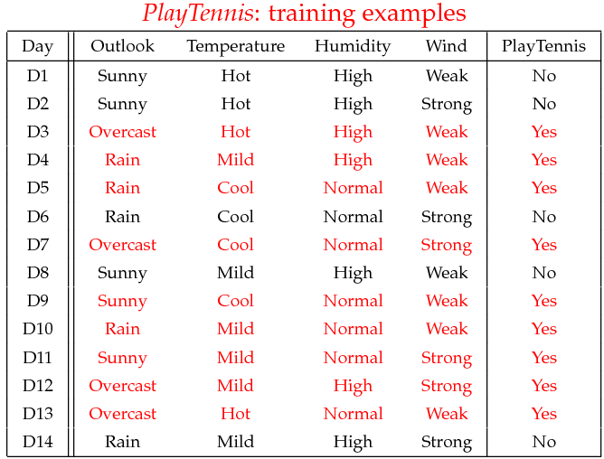
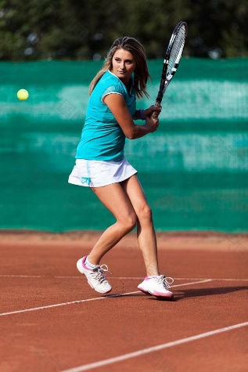





Example: Play tennis
$$X_{1}$$
$$X_{2}$$
$$X_{3}$$
$$X_{4}$$
$$C$$

Slide 14
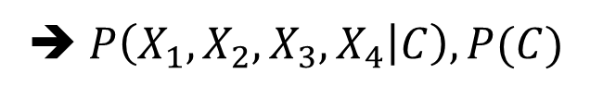
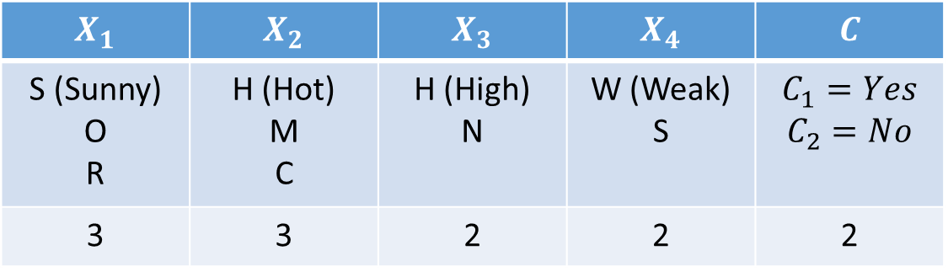



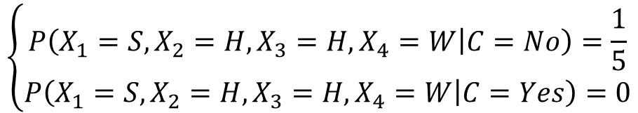

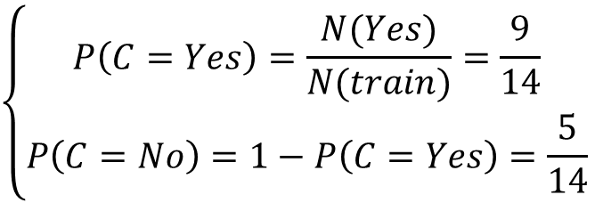
$$X_{1}$$ | $$X_{2}$$ | $$X_{3}$$ | $$X_{4}$$ | $$C$$
S (Sunny) O R | H (Hot) M C | H (High) N | W (Weak) S | $$C_{1}=Yes$$ $$C_{2}=No$$
3 | 3 | 2 | 2 | 2
$$×$$
$$×$$
$$×$$
$$×$$
72 parameters
➔ $P\left(X_{1},X_{2},X_{3},X_{4} | C\right),P(C)$
$$\left\{\begin{aligned}P\left(C=Yes\right)=\frac{N(Yes)}{N(train)}=\frac{9}{14} \\ P\left(C=No\right)=1−P\left(C=Yes\right)=\frac{5}{14}\end{aligned}\right.$$
①
$$\left\{\begin{aligned}P\left(X_{1}=S,X_{2}=H,X_{3}=H,X_{4}=W | C=No\right)=\frac{1}{5} \\ P\left(X_{1}=S,X_{2}=H,X_{3}=H,X_{4}=W | C=Yes\right)=0\end{aligned}\right.$$
②

Slide 15
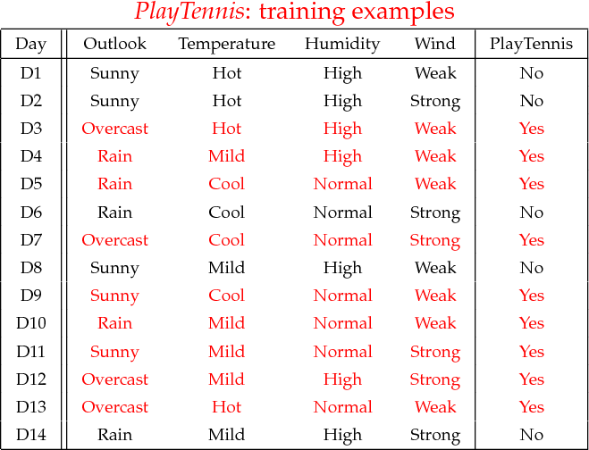
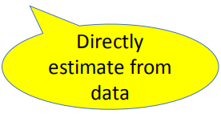


Learning: maximum likelihood estimates
simply use the frequencies in the data
e.g. $P\left(O,H,H,W | Yes\right)=\frac{1}{9}$
e.g. $P\left(O,H,H,W | No\right)=\frac{0}{5}=0$

Slide 16




Generative BC: Learning Phase
$$P(C1), P(C2), …, P(CL)$$
$$P(Play=Yes) = 9/14$$
$$P(Play=No) = 5/14$$
$$P(X1,X2 ,…, Xp|C1), P(X1,X2 ,…, Xp|C2)$$
Outlook (3 values) | Temperature (3 values) | Humidity (2 values) | Wind (2 values) | Play=Yes | Play=No
sunny | hot | high | weak | 0/9 | 1/5
sunny | hot | high | strong | …/9 | …/5
sunny | hot | normal | weak | …/9 | …/5
sunny | hot | normal | strong | …/9 | …/5
…. | …. | …. | …. | …. | ….
…. | …. | …. | …. | …. | ….
…. | …. | …. | …. | …. | ….
…. | …. | …. | …. | …. | ….
3*3*2*2 [conjunctions of attributes] * 2 [two classes]=72 parameters

Slide 17
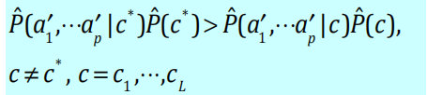
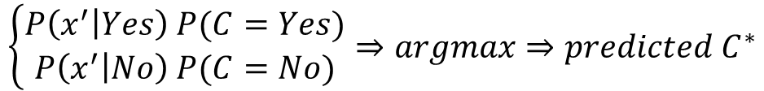
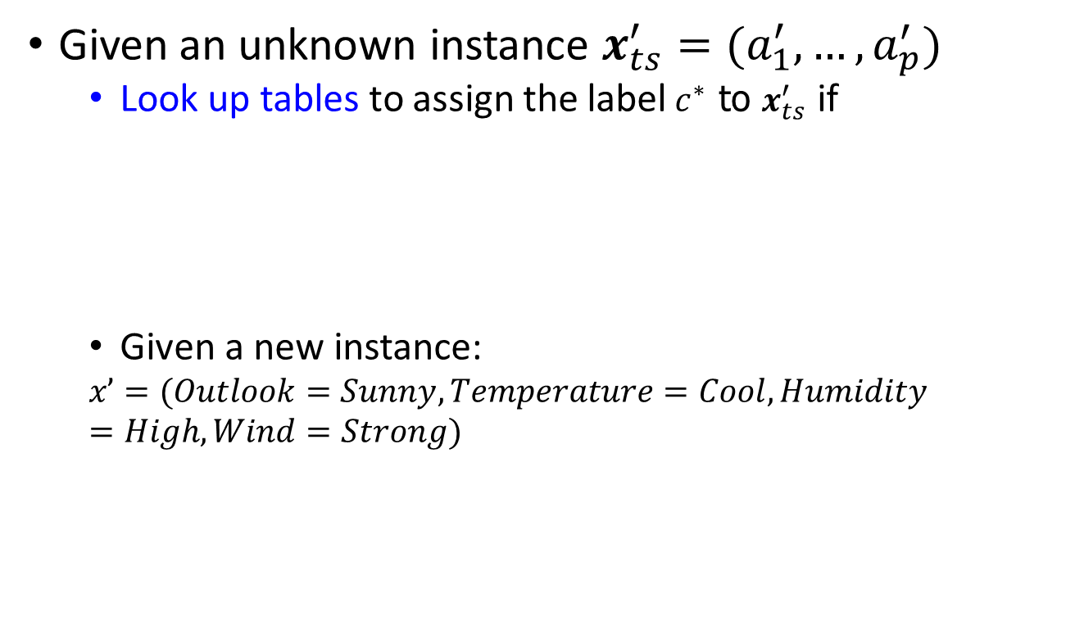

Generative BC: Testing Phase
Given an unknown instance $x_{ts}^{′}=(a_{1}^{′},…,a_{p}^{′})$
Look up tables to assign the label$c^{∗}$ to $x_{ts}^{′}$ if
Given a new instance:
$$xʼ=(Outlook=Sunny, Temperature=Cool, Humidity=High, Wind=Strong)$$
$$\left\{\begin{aligned}P\left(x^{′} | Yes\right) P(C=Yes) \\ P\left(x^{′} | No\right) P(C=No)\end{aligned}⇒argmax⇒predicted C^{∗}\right.$$
$$C$$

Slide 18
Today: Generative Bayes Classifiers
Bayes Classifier (BC)
Generative Bayes Classifier
Naïve Bayes Classifier
Gaussian Bayes Classifiers
Gaussian distribution
Naïve Gaussian BC
Not-naïve Gaussian BC LDA, QDA

Slide 19
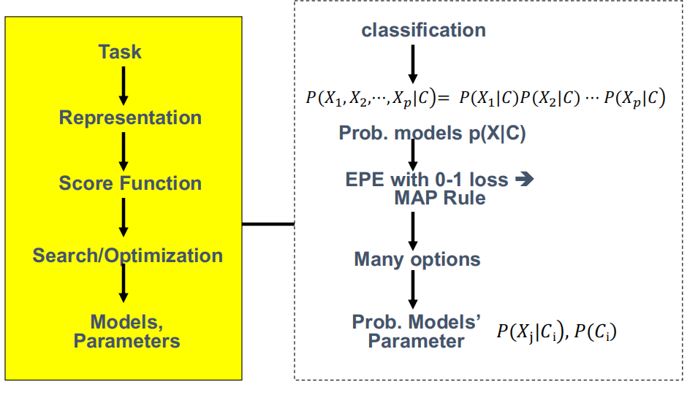
Naïve Bayes Classifier

Slide 20
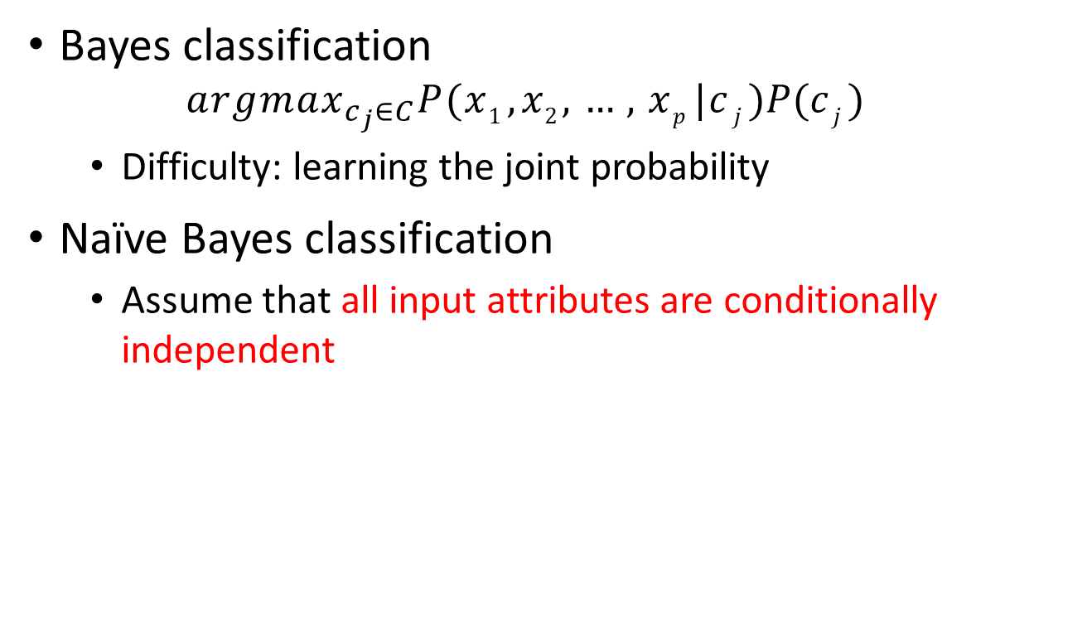
Naïve Bayes Classifier
Bayes classification
$${argmax}_{c_{j}∈C}P(x1 , x2 ,…, xp |c j )P(c j )$$
Difficulty: learning the joint probability
Naïve Bayes classification
Assume that all input attributes are conditionally independent

Slide 21
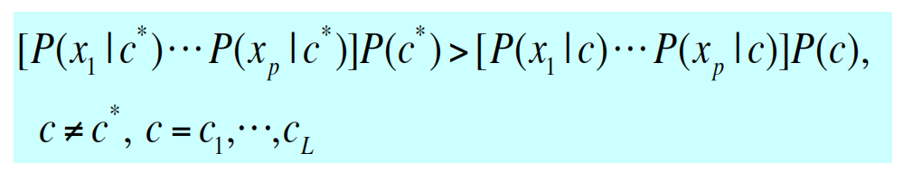
Naïve Bayes Classifier
Naïve Bayes classification
Assume that all input attributes are conditionally independent
MAP classification rule: for a sample x = (x₁ , x₂ ,⋅⋅⋅, x_{p} )
P( X₁ , X₂ ,⋅⋅⋅, X_{p} |C ) = P( X₁ |C )P( X₂ |C )⋅⋅⋅P( X_{p} |C )
Notes:
22-24页

Slide 22
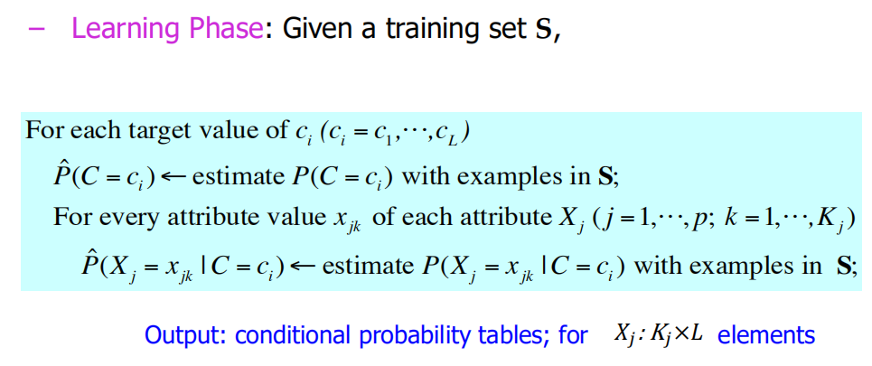
Naïve Bayes Classifier (for discrete input attributes) – Training / Learning

Slide 23
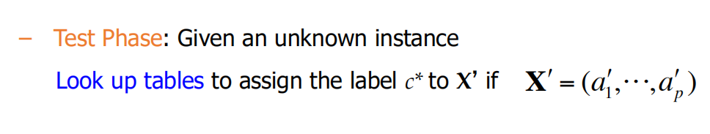
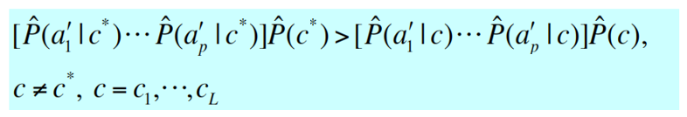
Naïve Bayes Classifier (for discrete input attributes) – Testing

Slide 24

Learning (training) the NBC Model
$$P(C_{1})∙∙∙P(C_{L})$$
C
X₁ X₂
X₃ X₄ X₅ X₆

Slide 25
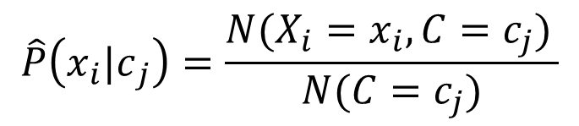
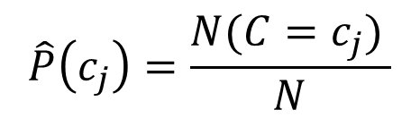
Learning (training) the NBC Model
$$P(C_{1})∙∙∙P(C_{L})$$
C
X₁ X₂
X₃ X₄ X₅ X₆
maximum likelihood estimates:
simply use the frequencies in the data
$$\hat{P}\left(c_{j}\right)=\frac{N(C=c_{j}) }{N}$$
$$\hat{P}\left(x_{i}{|c}_{j}\right)=\frac{N(X_{i}=x_{i},C=c_{j}) }{N(C=c_{j})}$$

Slide 26


Example: Play tennis
[ ]
[ ]
$$P\left(X_{1}=Rain | C=Yes\right)=\frac{3}{9}$$
[ ]
$$P\left(X_{1}=Rain | C=No\right)=\frac{2}{5}$$

Slide 27
Estimate P( X _{j} = x _{jk} |C = c_{i} ) with examples in training;
Learning Phase
P(X₂|C₁), P(X₂|C₂)
Outlook | Play=Yes | Play=No
Sunny
Overcast
Rain
Temperature | Play=Yes | Play=No
Hot
Mild
Cool
P(X₄|C₁), P(X₄|C₂)
Humidity | Play=Yes | Play=No
High
Normal
Wind | Play=Yes | Play=No
Strong
Weak
P(Play=Yes) = ??
P(Play=No) = ??
P(C₁), P(C₂), …, P(C_{L})

Slide 28
Estimate P( X _{j} = x _{jk} |C = c_{i} ) with examples in training;
Learning Phase
P(X₂|C₁), P(X₂|C₂)
Outlook | Play=Yes | Play=No
Sunny | 2/9 | 3/5
Overcast | 4/9 | 0/5
Rain | 3/9 | 2/5
Temperature | Play=Yes | Play=No
Hot | 2/9 | 2/5
Mild | 4/9 | 2/5
Cool | 3/9 | 1/5
P(X₄|C₁), P(X₄|C₂)
Humidity | Play=Yes | Play=N o
High | 3/9 | 4/5
Normal | 6/9 | 1/5
Wind | Play=Yes | Play=No
Strong | 3/9 | 3/5
Weak | 6/9 | 2/5
3+3+2+2 [naïve assumption] * 2 [two classes]= 20 parameters
P(Play=Yes) = 9/14
P(Play=No) = 5/14
P(C₁), P(C₂), …, P(C_{L})

Slide 29
Example: Play tennis
Test Phase
Given a new instance,
xʼ=(Outlook=Sunny, Temperature=Cool, Humidity=High, Wind=Strong)

Slide 30
Example: Play tennis
Test Phase
Given a new instance,
xʼ=(Outlook=Sunny, Temperature=Cool, Humidity=High, Wind=Strong)
Look up in conditional-prob tables
P(Outlook=Sunny|Play=Yes) = 2/9
P(Temperature=Cool|Play=Yes) = 3/9 P(Huminity=High|Play=Yes) = 3/9
P(Wind=Strong|Play=Yes) = 3/9 P(Play=Yes) = 9/14
P(Outlook=Sunny|Play=No) = 3/5
P(Temperature=Cool|Play==No) = 1/5 P(Huminity=High|Play=No) = 4/5 P(Wind=Strong|Play=No) = 3/5 P(Play=No) = 5/14

Slide 31

Testing the NBC Model
P(Outlook=Sunny|Play=Yes) = 2/9
P(Temperature=Cool|Play=Yes) = 3/9 P(Huminity=High|Play=Yes) = 3/9
P(Wind=Strong|Play=Yes) = 3/9 P(Play=Yes) = 9/14
P(Outlook=Sunny|Play=No) = 3/5
P(Temperature=Cool|Play==No) = 1/5 P(Huminity=High|Play=No) = 4/5 P(Wind=Strong|Play=No) = 3/5 P(Play=No) = 5/14
– MAP rule
P(Yes|x’):[P(Sunny|Yes)P(Cool|Yes)P(High|Yes)P(Strong|Yes)]P(Play=Yes) = 0.0053
P(No|x’):[P(Sunny|No)P(Cool|No)P(High|No)P(Strong|No)]P(Play=No) = 0.0206
Given the fact P(Yes|x’) < P(No|x’), we label x’ to be “No”.

Slide 32


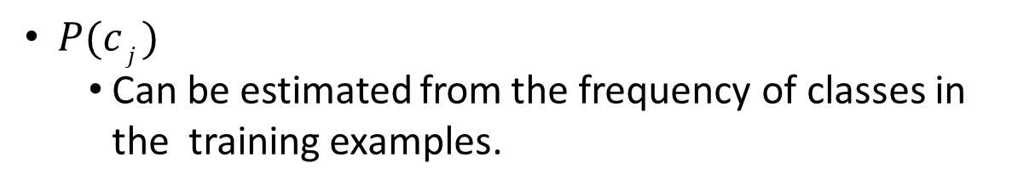
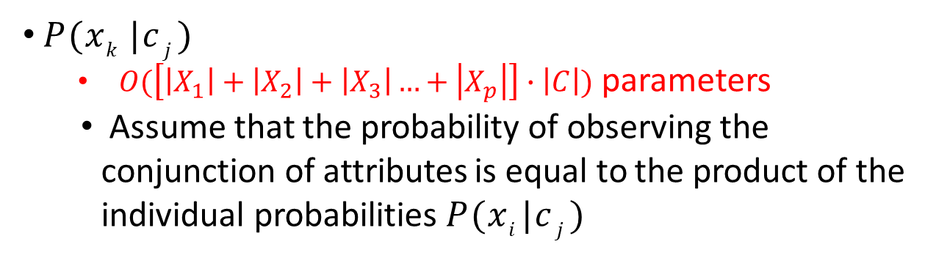
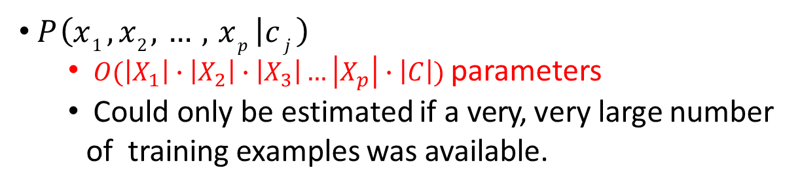
Why Naïve Bayes Assumption
$P(c j )$
Can be estimated from the frequency of classes in the training examples.
$P\left(x1 , x2 ,…, xp | c j \right)$
$O(\left|X_{1}\right|∙\left|X_{2}\right|∙\left|X_{3}\right|…\left|X_{p}\right|∙\left|C\right|)$ parameters
Could only be estimated if a very, very large number of training examples was available.
Not Naïve
• $P(xk |c j )$
$O(\left[\left|X_{1}\right|+\left|X_{2}\right|+\left|X_{3}\right|…+\left|X_{p}\right|\right]∙\left|C\right|)$ parameters
Assume that the probability of observing the conjunction of attributes is equal to the product of the individual probabilities $P(xi |c j )$
Naïve
Notes:
这页的公式手打一下

Slide 33

Challenges during learning the NBC Model
$$P(C_{1})∙∙∙P(C_{L})$$
C
X₁ X₂
X₃ X₄ X₅ X₆
For instance:
C=Flu
X₁
X₂
X₃ X₄ X₅
X₆=Muscle-ache

Slide 34


Challenges during learning the NBC Model
For instance:
What if we have seen no training cases where patient had no flu and muscle aches?
Zero probabilities cannot be conditioned away, no matter the other evidence!

Slide 35

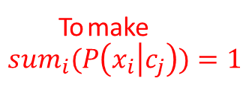


Smoothing to Avoid Overfitting
$$N \left( X_{i}=x_{i} , C=c j \right)+1$$
ˆ
P(x | c )
=
i j
$$N \left(C=c j \right)+k_{i}$$
To make ${sum}_{i}(P\left(x_{i} | c_{j}\right))=1$
number of values of feature X_{i}

Slide 36




Smoothing to Avoid Overfitting
N( X_{i} = x_{i} ,C = c _{j} )+ 1
N(C = c _{j} )+ k_{i}
number of values of X_{i}
overall fraction in data where X_{i}=x_{i,k}
Somewhat more subtle version
N ( X_{i} = x_{i,k} , C = c
) + mp
j
i,k
N (C = c ) + m
$$k∈\{1,2,…,k_{i}\}$$
j
extent of
“smoothing”

Slide 37

Summary: Generative Bayes Classifier
Task: Classify a new instance X based on a tuple of attribute values $X=<X1, X2,…, Xp>$into one of the classes
c_{MAP} = argmax P(c_{j} | x₁, x₂,…, x_{p} )
c_{j} ∈C
P(x₁, x₂,…, x_{p} | c_{j} )P(c_{j} )
= argmax
c_{j} ∈C
P(x₁, x₂,…, x_{p} )
= argmax P(x₁, x₂,…, x_{p} | c_{j} )P(c_{j} )
c_{j} ∈C
MAP = Maximum A Posteriori

Slide 38
Next: Generative Bayes Classifiers
Bayes Classifier (BC)
Generative Bayes Classifier
Naïve Bayes Classifier
Gaussian Bayes Classifiers
Gaussian distribution
Naïve Gaussian BC
Not-naïve Gaussian BC LDA, QDA

Slide 39
References
https://qiyanjun.github.io/2019f-UVA-CS6316-MachineLearning/
Prof. Andrew Moore’s review tutorial
Prof. Ke Chen NB slides
Prof. Carlos Guestrin recitation slides

Slide 40
Thanks for listening

